Slide 1
USA USA USA USA USA

Slide 2
There are 316 million inhabitants.

Slide 3
The emblem is an eagle.

Slide 4
The president is Barack Obama He lives at White House It is situated in Washington DC

Slide 5
The capital is Washington DC

Slide 6
The biggest city is New York

Slide 7
The National Day is July 4th It is called Independence Day It commemorates the Declaration of Independence in 1776

Slide 8
The first president was George Washington.

Slide 9
The Native Americans were Indians

Slide 10
The first Europeans arrived in 1620 : the Pilgrim Fathers.
Their boat was the Mayflower.

Slide 11
Abraham Lincoln Abolished slavery and died assassinated in 1865, at the end of the Civil War

Slide 12
The American flag is called « Stars and Stripes » or « Star-spangled Banner

Slide 13
There are 50 stars for the 50 states
The red and the white stripes represent the first 13 colonies

Slide 14
The Golden Gate Bridge is famous in San francisco

Slide 15
The 4 presidents on Mount Rushmore are George Washington, Thomas Jefferson, Theodore Roosevelt and Abraham Lincoln

Slide 16
The most popular sport is baseball.

Slide 17
The highest skyscraper in New York is the Empire State Building

Slide 18
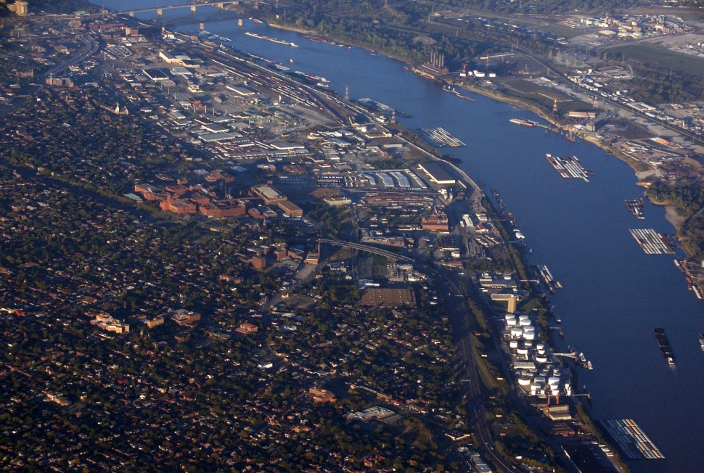
The longest river is the Mississippi.

Slide 19
The Statue of Liberty was a gift from France (1886).

Slide 20
The end
The end

