Slide 1
The United States of America USA
By Maéva Buisson – 4B

Slide 2
Map of the U.S.A.

Slide 3
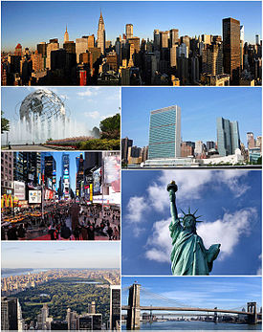
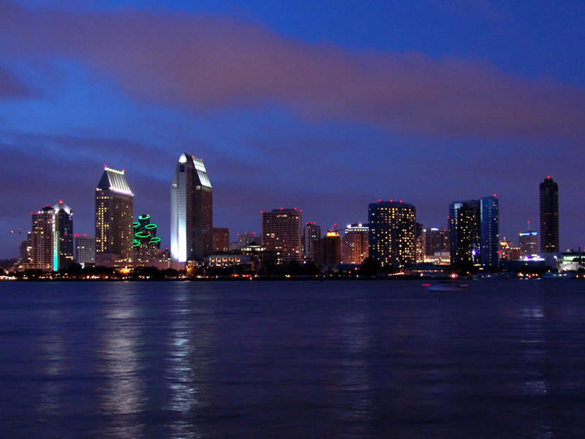
A minimum of things to be known about the United States.
There are 316 million inhabitants.
There are 50 states.
The biggest city is New-York.
The capital is Washington D.C..

Slide 4
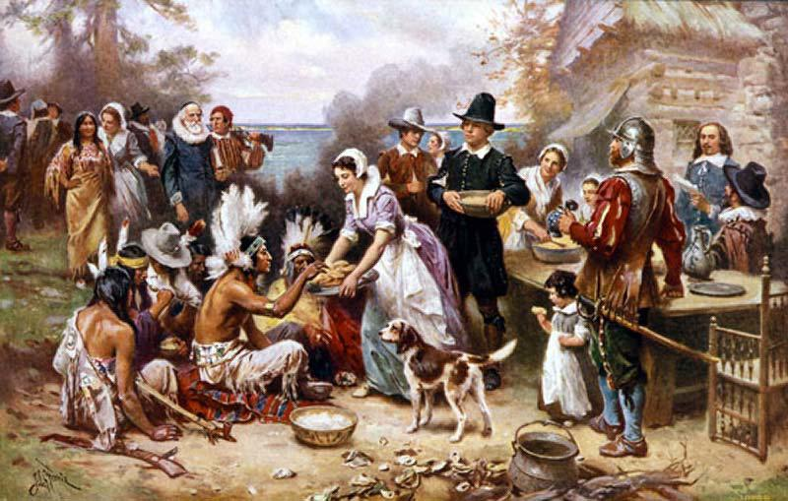
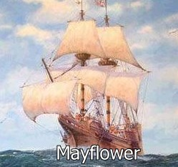
A little of history…
The native Americans were Indians
Their boat was the Mayflower
The first Europeans arrived in 1620 : the Pilgrim Fathers

Slide 5
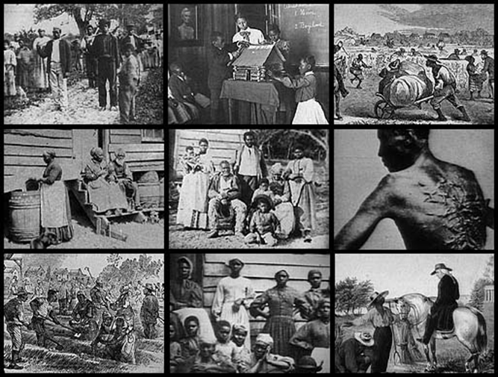
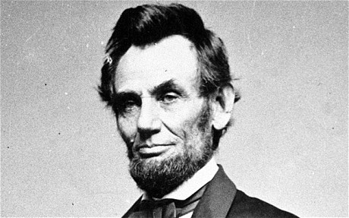
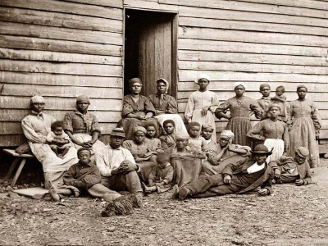
The first Black slaves arrived at the end of the 17th century.
Abraham LINCOLN abolished slavery and died assassinated in 1865, at the end of the Civil War.

Slide 6
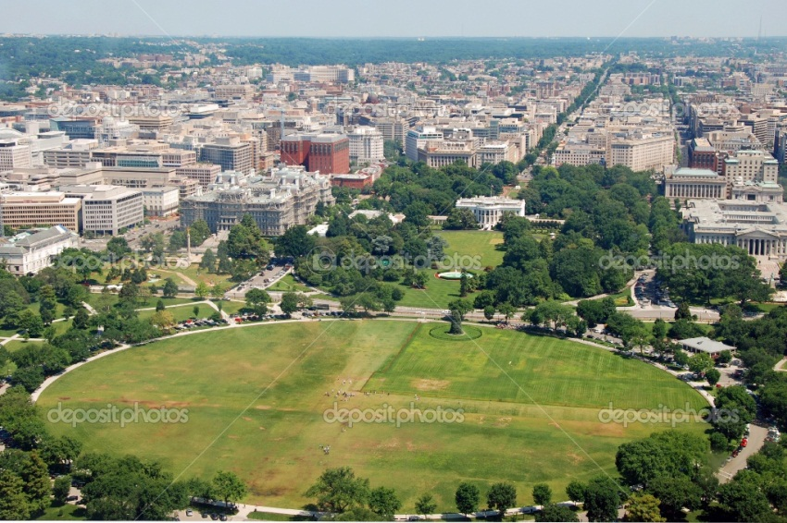
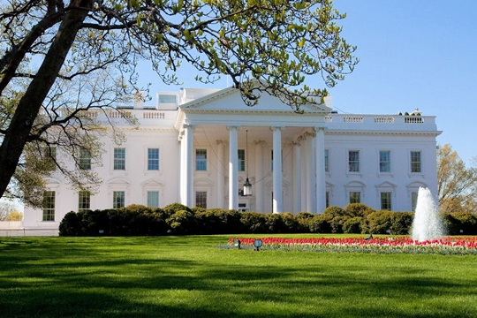
The president
The president is Barack OBAMA.
He lives at the White House,
it is situated in Washington D.C.
The first president was Georges Washington

Slide 7
The emblem is an eagle

Slide 8
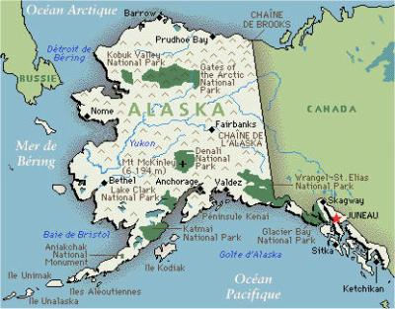
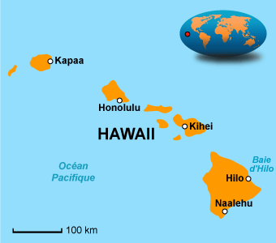
The flag
The American flag is called « Stars and Stripes », « Star-Spangled Banner » or « The Old Glory ».
The red and white stripes represent the first 13 colonies.
There are 50 stars for the 50 states.
The two last stars were added in 1659 when Alaska and Hawaï joined the USA.

Slide 9
The National day
The National day is July 4th : it is called Independence day.
It commemorates the Declaration of Independence in 1776.

Slide 10
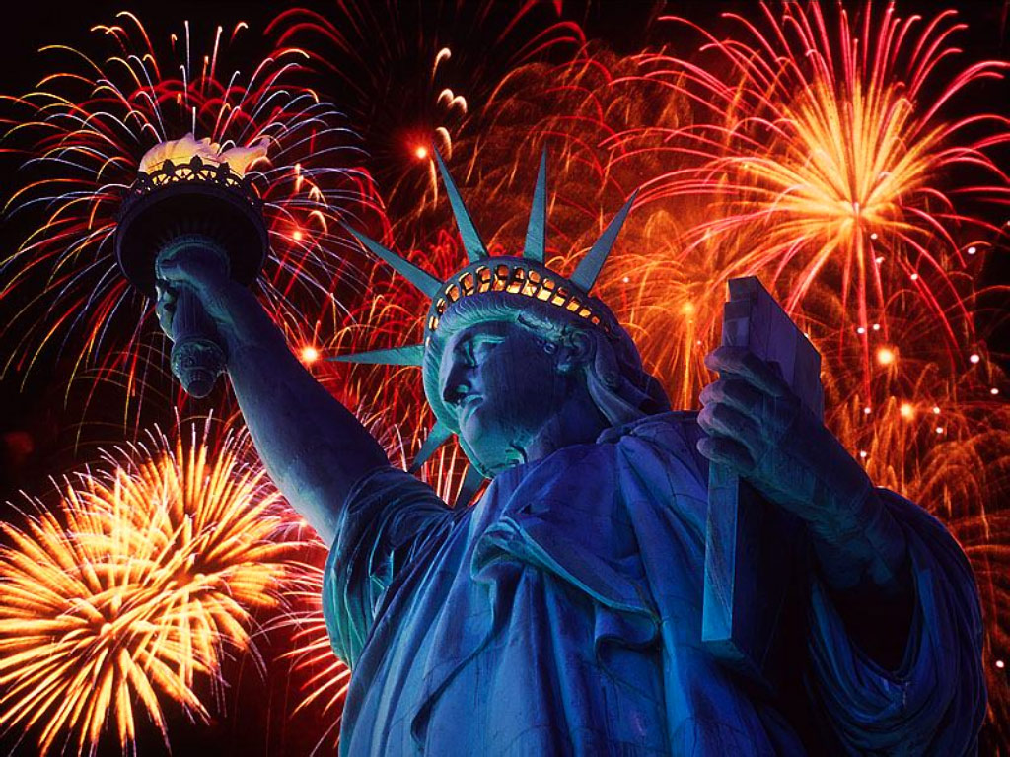
Some famous monuments
New York
The statue of Liberty was a gift of friendship from France (1886)

Slide 11
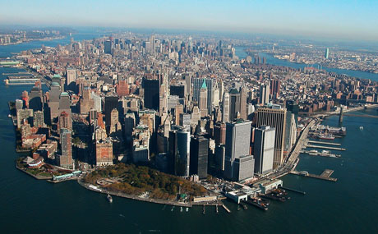
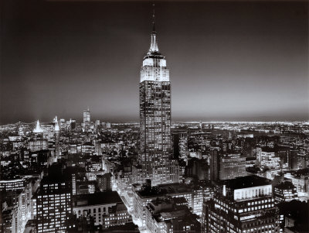
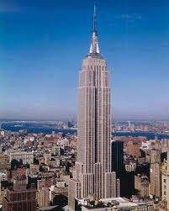
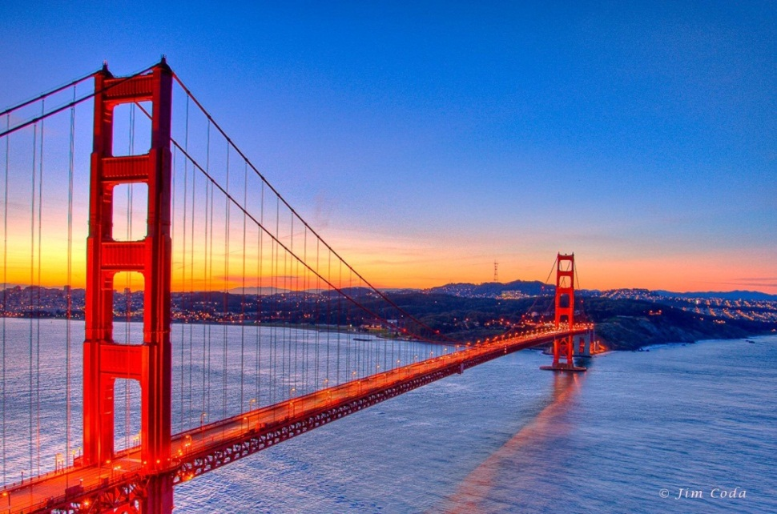
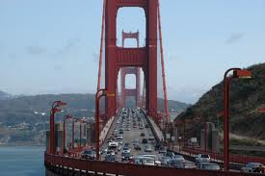
The highest skyscraper in New York is the Empire State Building
The Golden Gate Bridge is famous in San Francisco

Slide 12
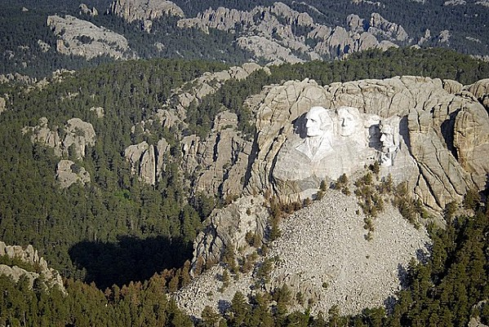
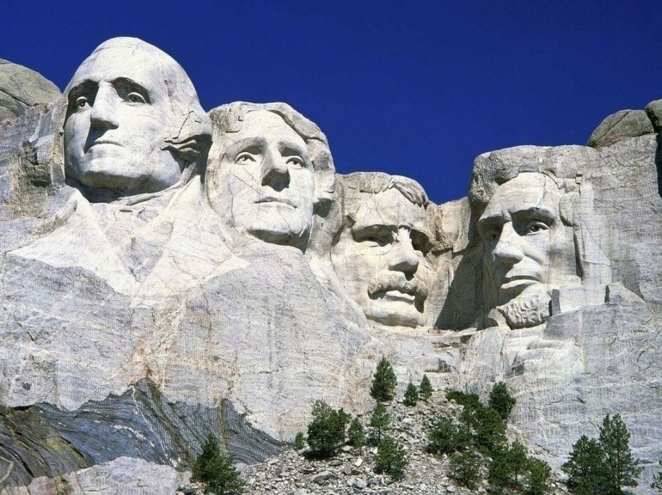
Mount Rushmore
National Park in the Black Hills of South Dakota.
The 4 presidents on Mount Rushmore are :
Georges WASHINGTON
Thomas JEFFERSON
Theodore ROOSEVELT
Abraham LINCOLN
Head = 60 feet tall (18 meter tall)

Slide 13
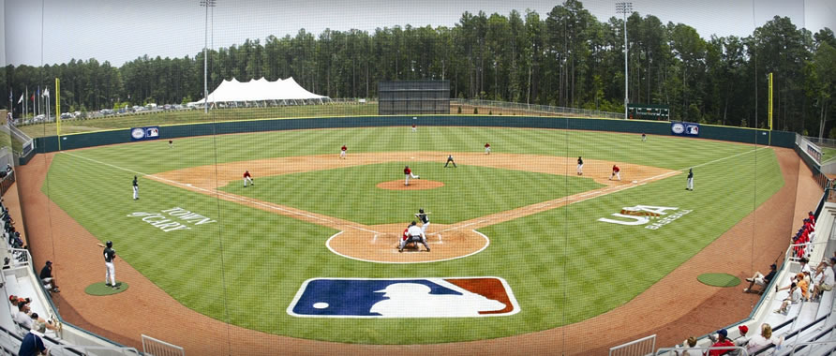
The most popular sport is :
baseball

Slide 14
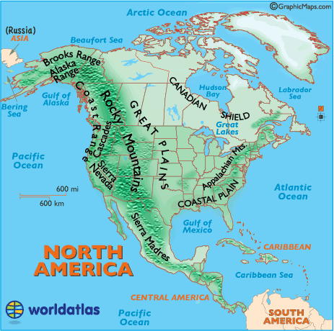
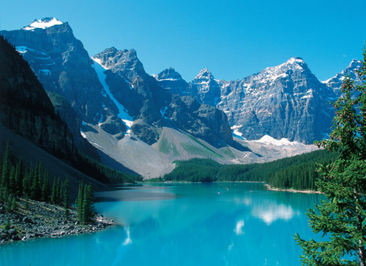
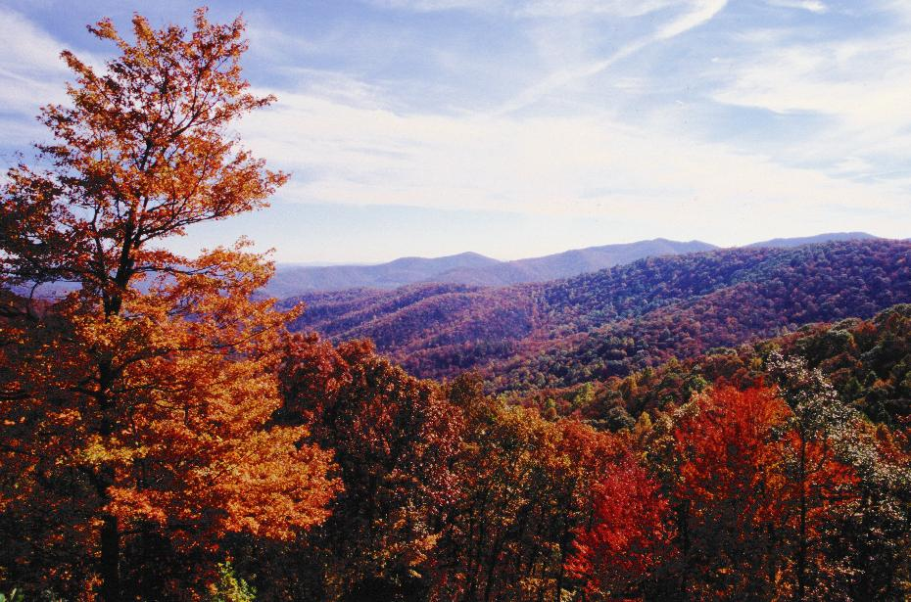
Mountains & river
The two mountain ranges are :
The Appalachians
The Rocky mountains

Slide 15
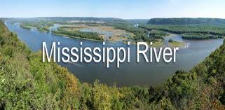
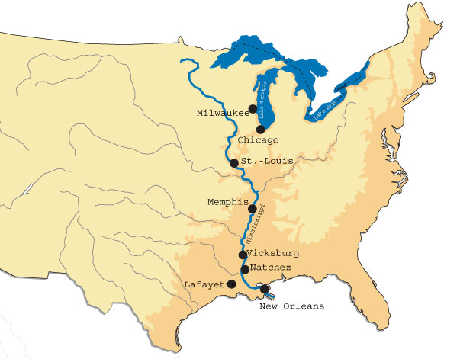
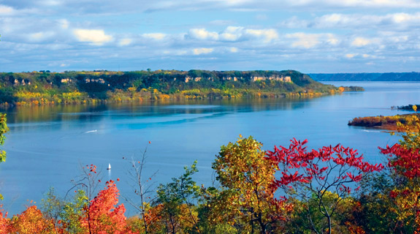
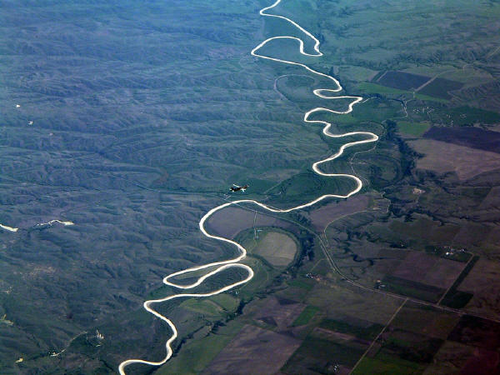
The longest river is the Mississippi
The length of the Mississippi River is approximately 2320 miles (3730 km)

Slide 16
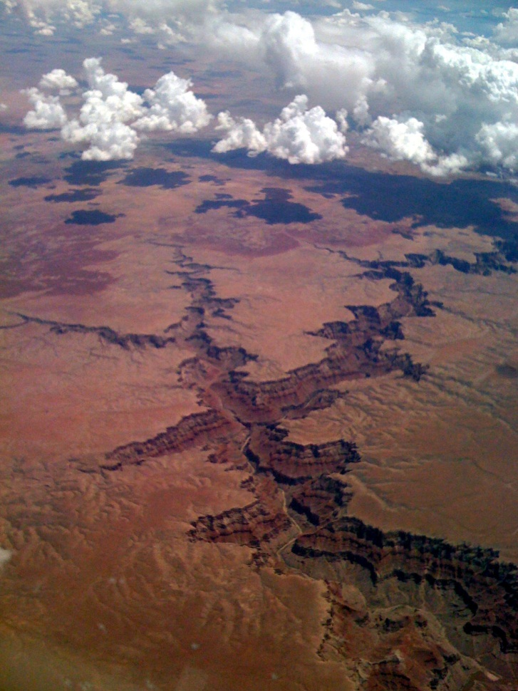
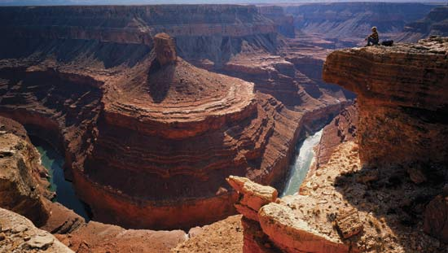
The USA has got the most spectacular gorge in the world
The Grand Canyon
Carved by the Colorado River
Length : 277 miles (446 km)
In the North West of Arizona.
Its shapes and colours are fantastic !...

Slide 17
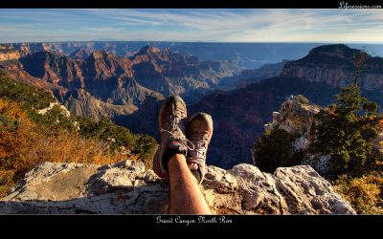
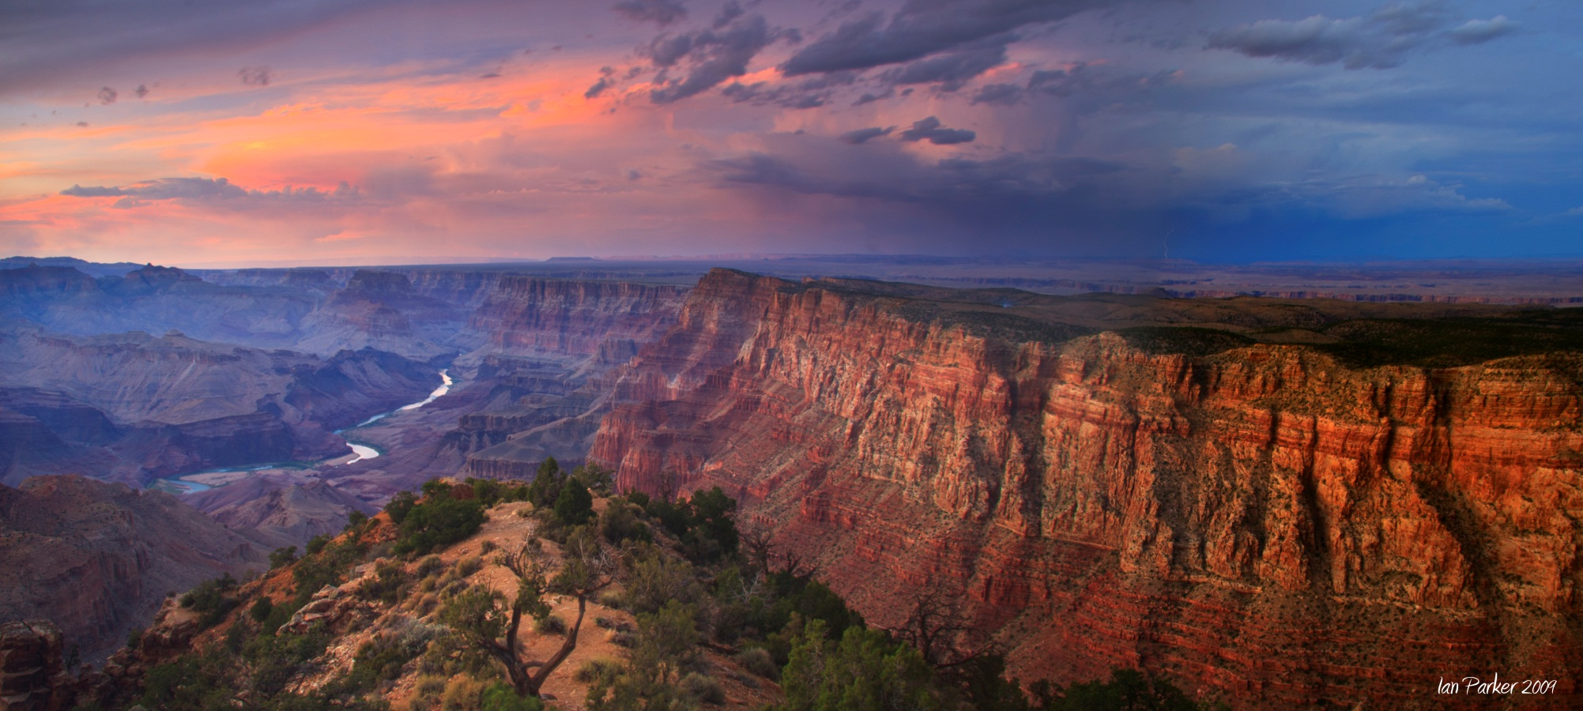

Slide 18
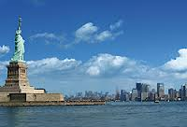
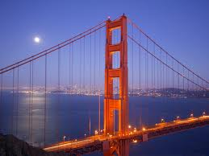
The End

