Slide 1
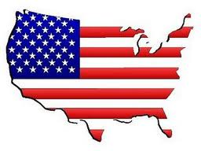
The United States

Slide 2
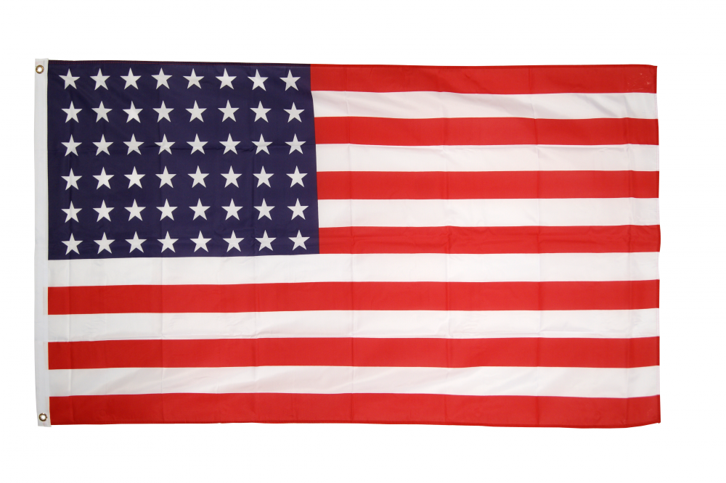
The two American flag
48 stars
Former flag
50 stars
New flag
The red and white stripes repesent the first colonies .

Slide 3
The capital : Washington D.C.

Slide 4
NEW YORK The largest city

Slide 5
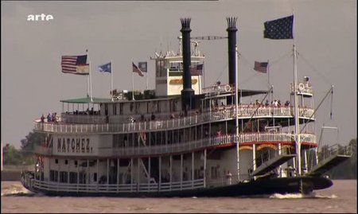
Mississippi

Slide 6
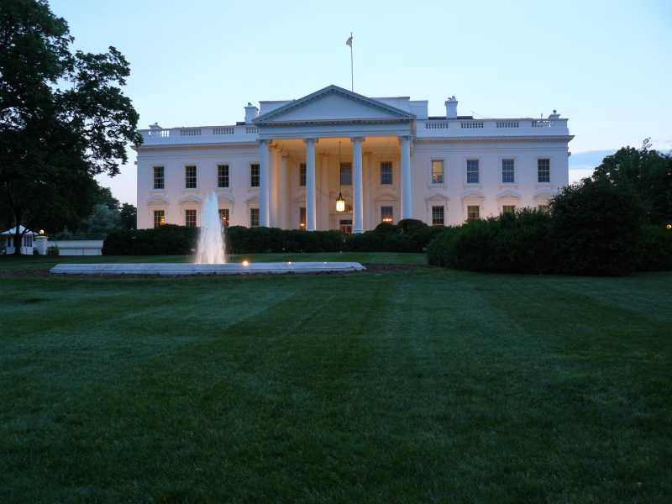
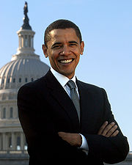
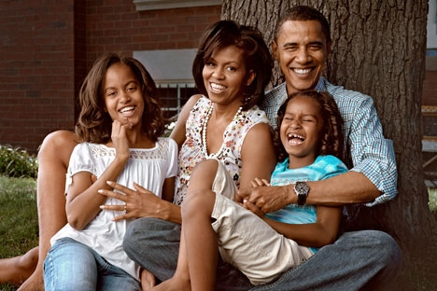
Barack Obama
The White House
The family of Barack Obama

Slide 7
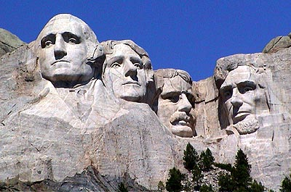
The four presidents on Mount
Rushmore
Georges
Washington
Abraham
lincoln
Thomas
Jefferson
Theodore
Roosevelt

Slide 8
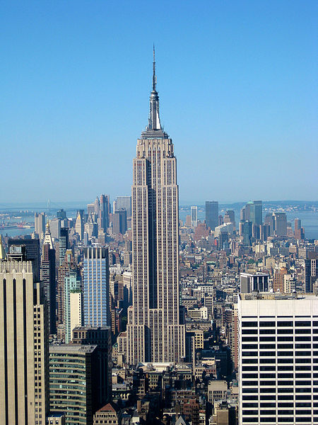
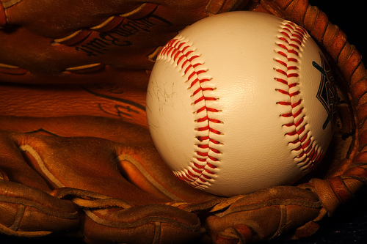
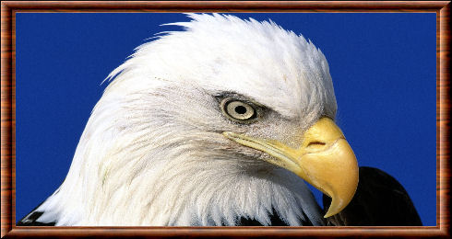
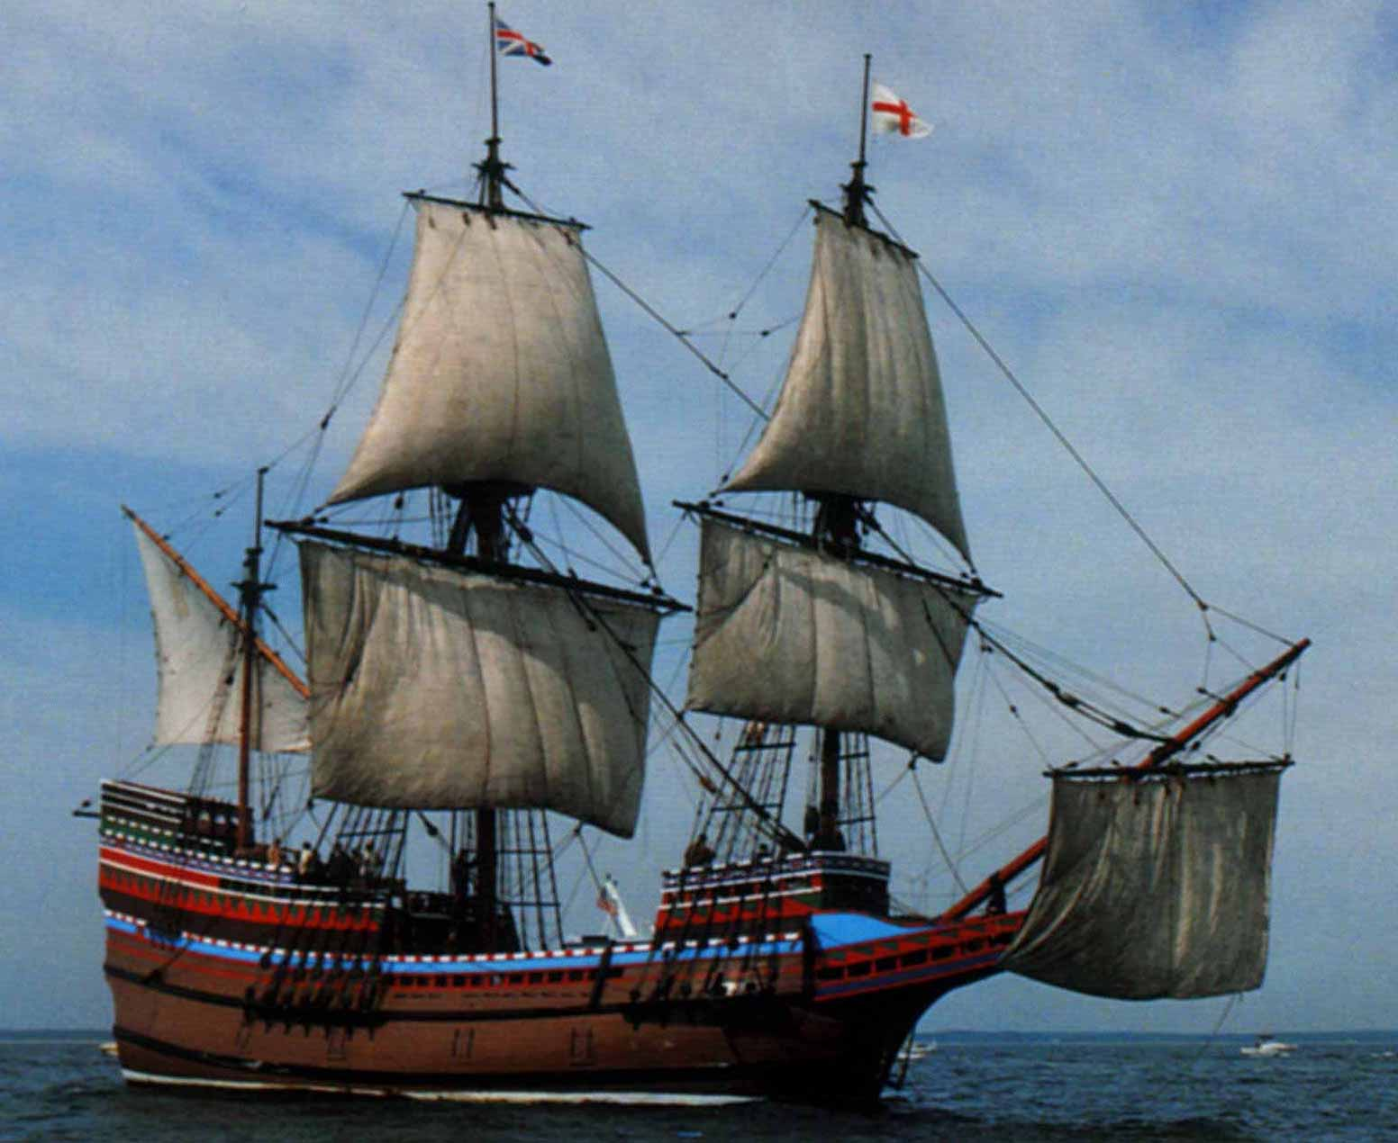
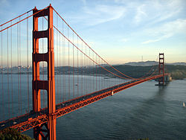
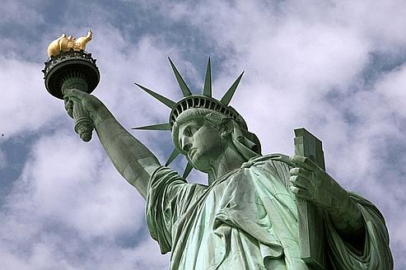
THE EMBLEM

Slide 9
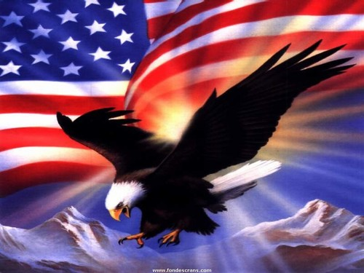
The emblem is a eagle

Slide 10
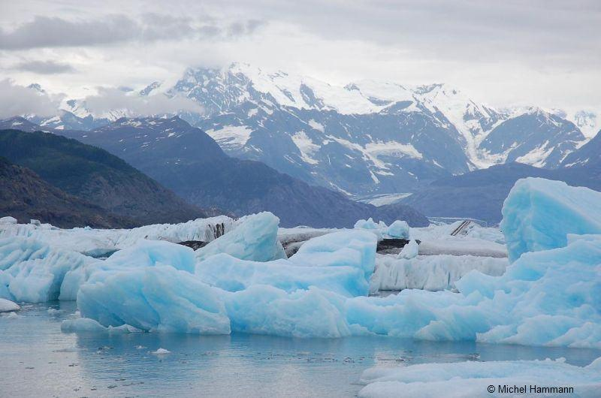
THE TWO LAST STARS WERE ABBED IN 1959 WHEN ALASKA AND HAWAI JOINED THE U.S.A.
Alaska
Hawaï

Slide 11
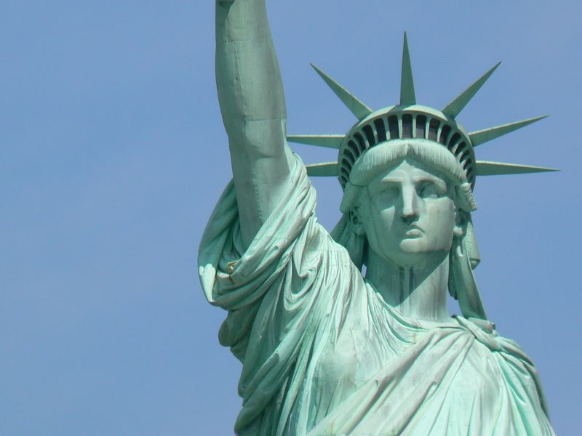
THE STATUE OF LIBERTY WAS A GIFT FROM FRANCE

Slide 12
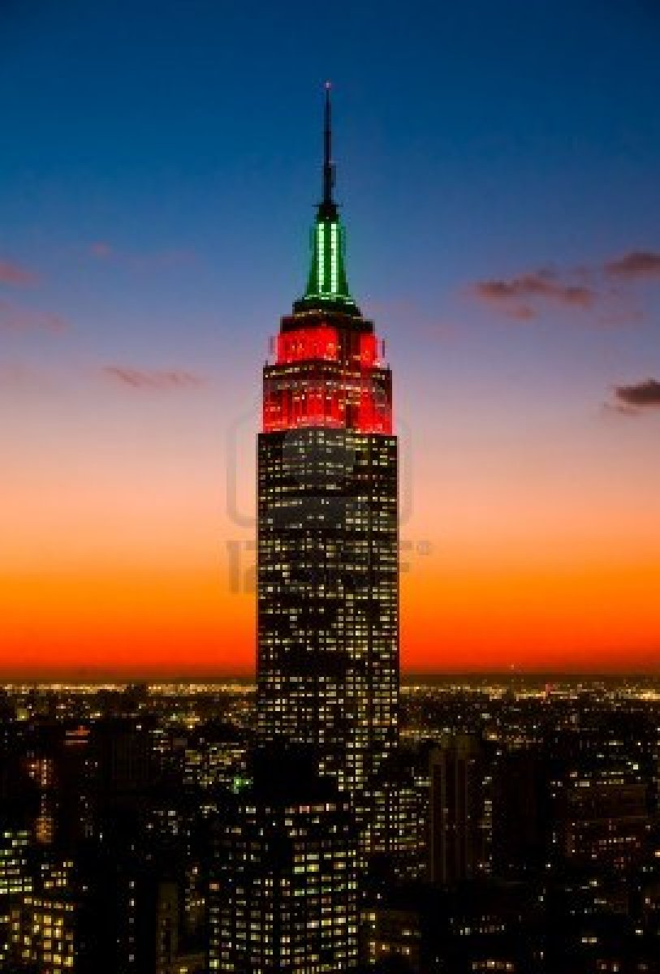
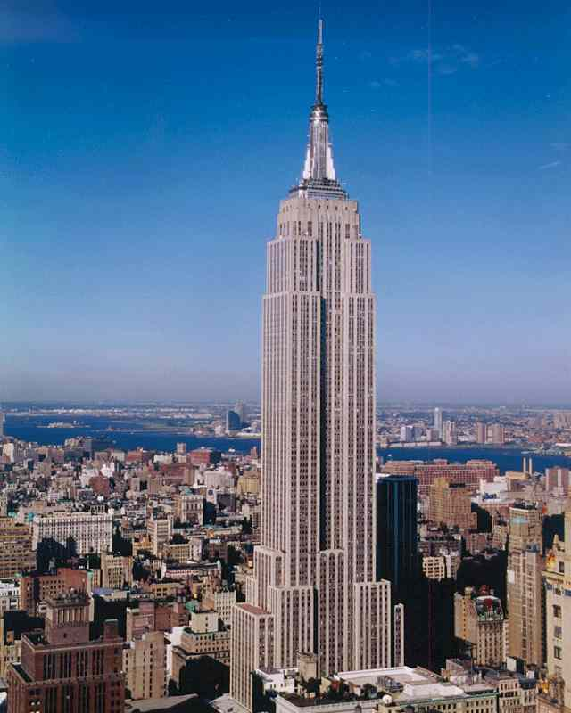
The highest skyscraper in New -
York is
the empire State Building

Slide 13
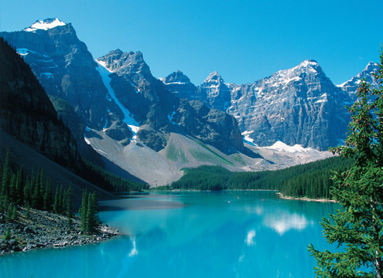
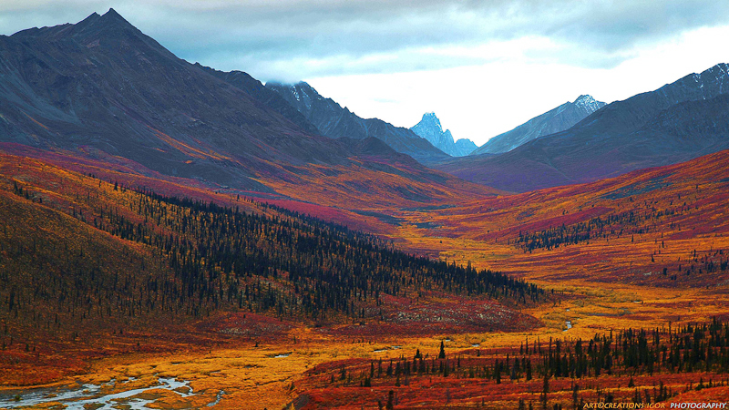
The two mountain ranges
Rocky Mountains
Appalachians

Slide 14
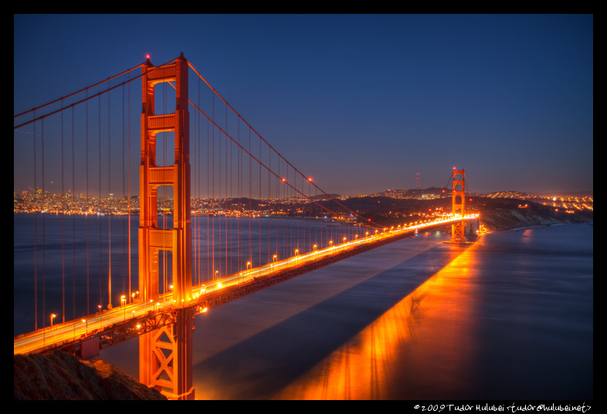
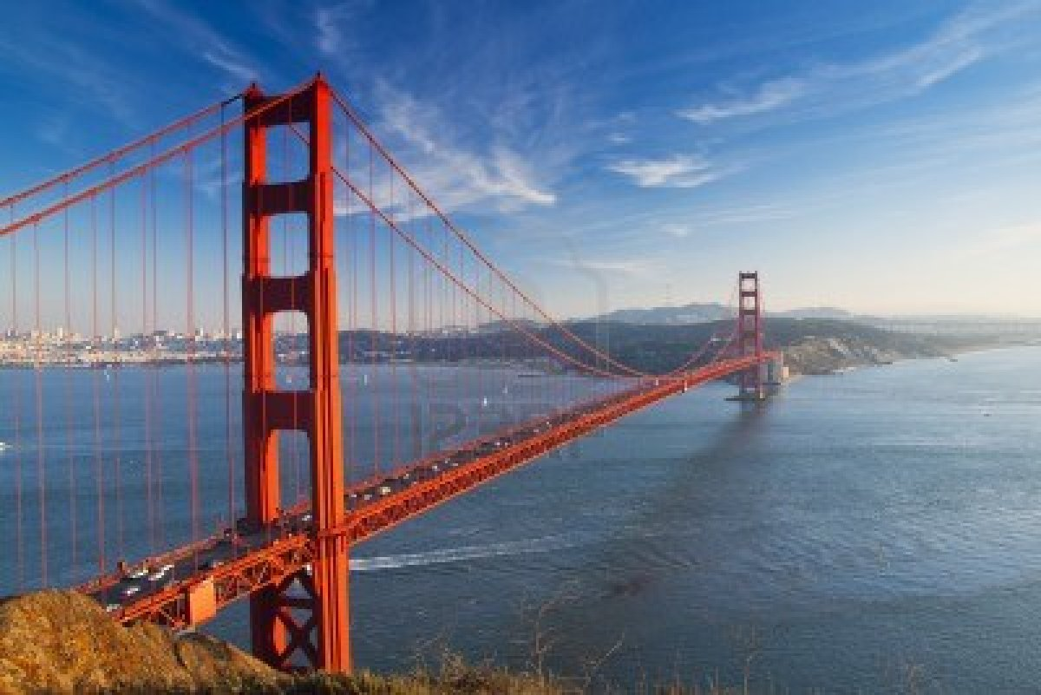
The Golden Bridge is famous in San Francisco

Slide 15
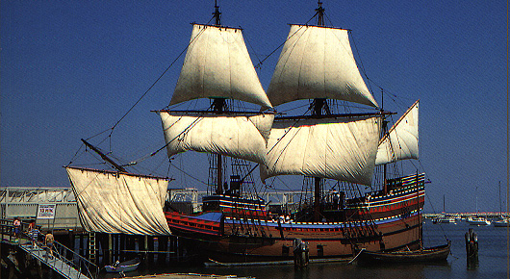
Their boat was the Mayflower

Slide 16
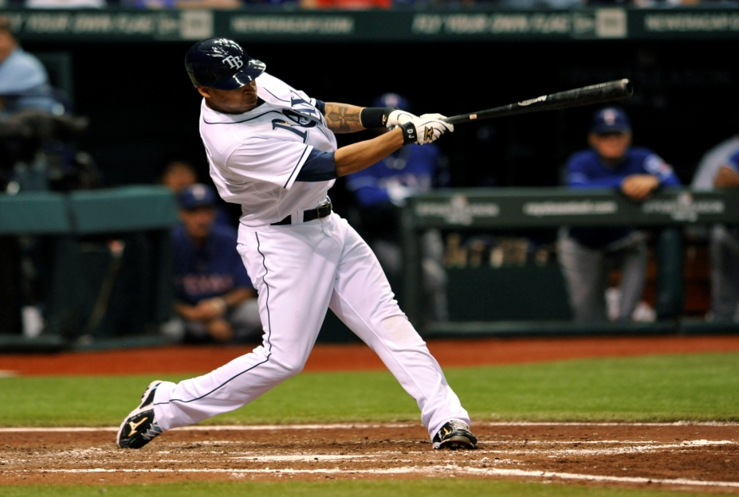
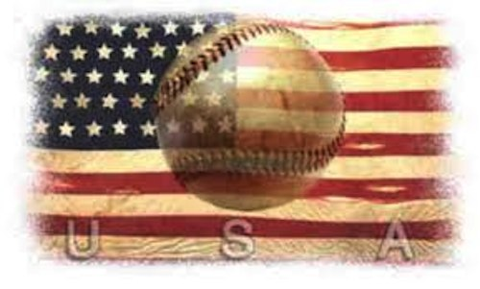
THE MOST POPULAR SPORT IS A BASEBALL

Slide 17
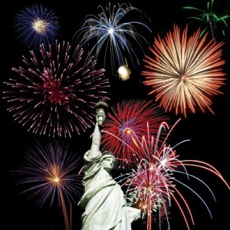
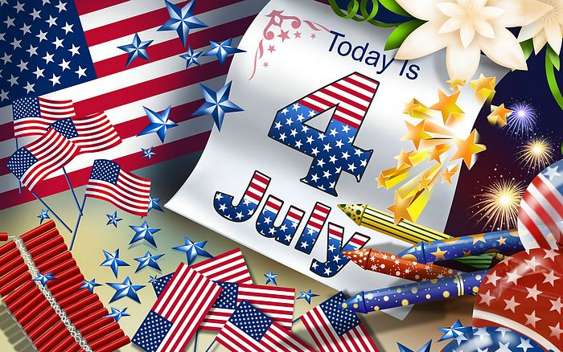
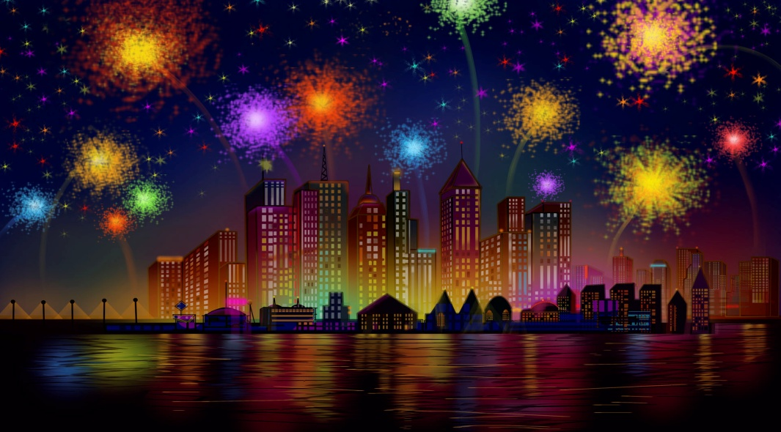
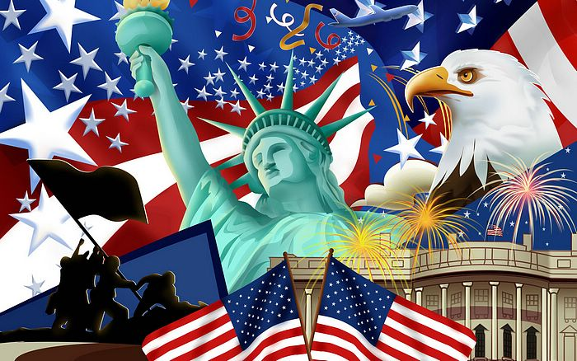
INDEPANDANCE DAY

